Slide 1
Association VS Aggregation VS Composition

Slide 2
Association
Association can be considered a generic term to indicate the relationship between two independent classes.
Relationship may be one-to-one, one-to-many, or many-to-many, but it need not indicate ownership.
Association can be viewed as describing a "uses-a" relationship where an object uses, or in any way interacts with, another object.

Slide 3
Types of Association
Unidirectional Association: This association is the one in which one class is aware and associated with another class; the reverse is not true.
For example, the Student class can be associated with the LibraryCard class, for the association where the student has a library card; a LibraryCard does not need to 'know about' a Student.
Bidirectional Association: In this type of association, the classes are aware of each other and interact with one another.
For example, a Teacher class and a Classroom class may be associated bidirectionally; there would be a teacher assigned to a classroom, and a classroom would know to which teacher it is assigned.

Slide 4
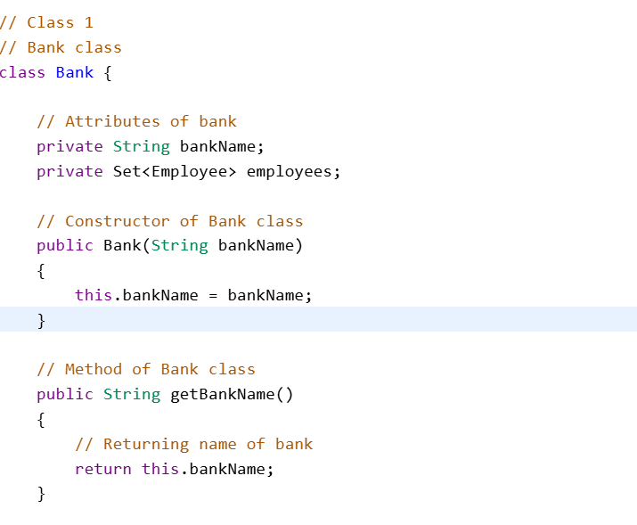
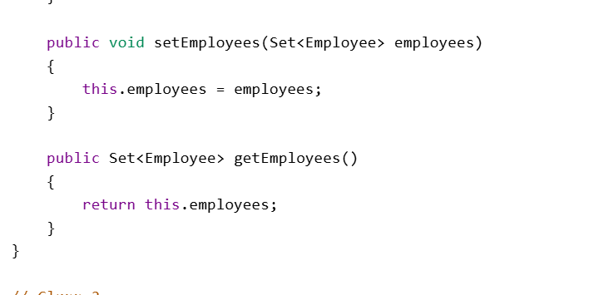
Code Example

Slide 5
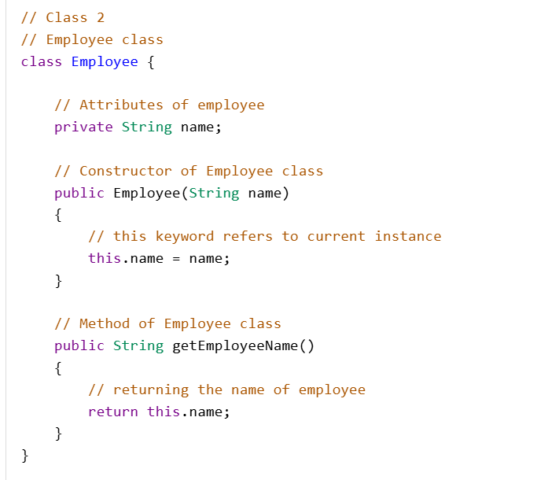

Slide 6
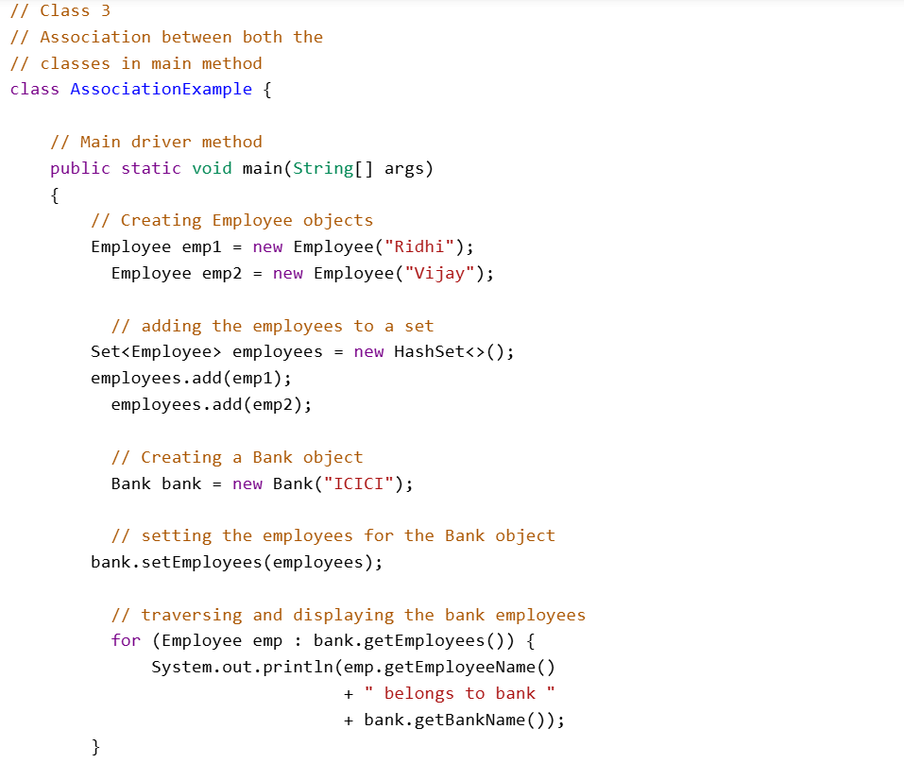

Slide 7
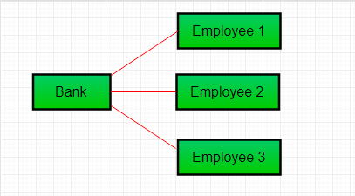
Association Example

Slide 8
Aggregation
Aggregation is a specific form of association in which one class, the whole, contains a collection of other classes, the parts; here, however, the lifecycle of the parts does not depend upon the whole.
For example, a library and books show aggregation, since books may exist somewhere apart from the library.
It is a special form of Association where:
It represents Has-A's relationship.
It is a unidirectional association i.e. a one-way relationship. For example, a department can have students but vice versa is not possible and thus unidirectional in nature.
In Aggregation, both entries can survive individually which means ending one entity will not affect the other entity.

Slide 9
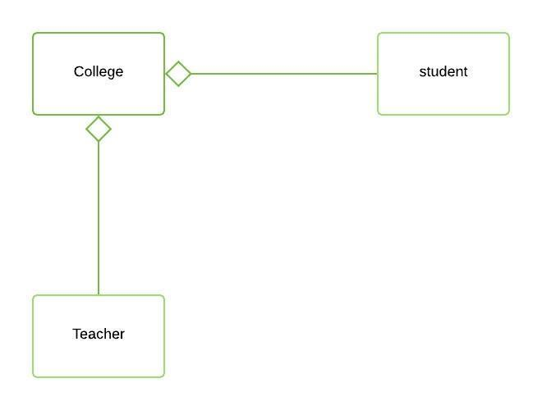
Aggregation Example

Slide 10
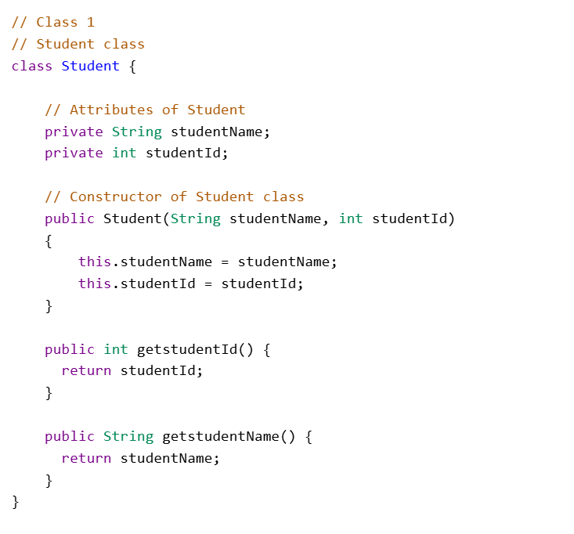
Code Example

Slide 11
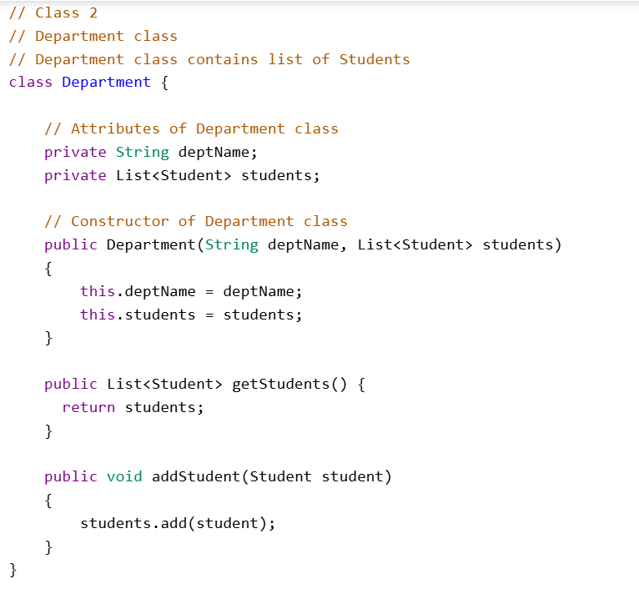

Slide 12
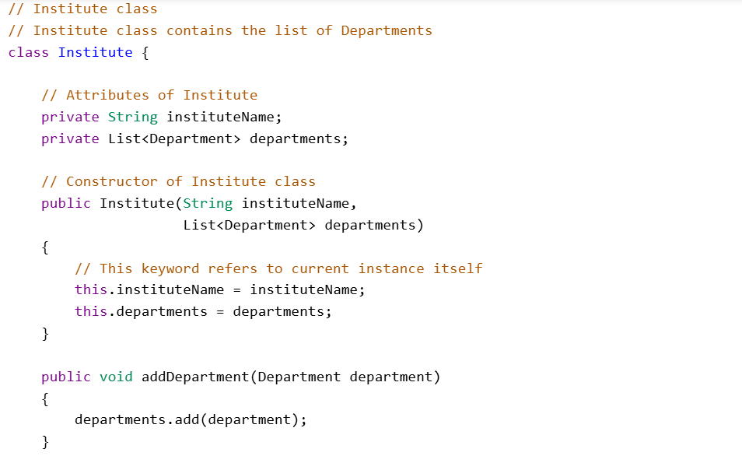

Slide 13
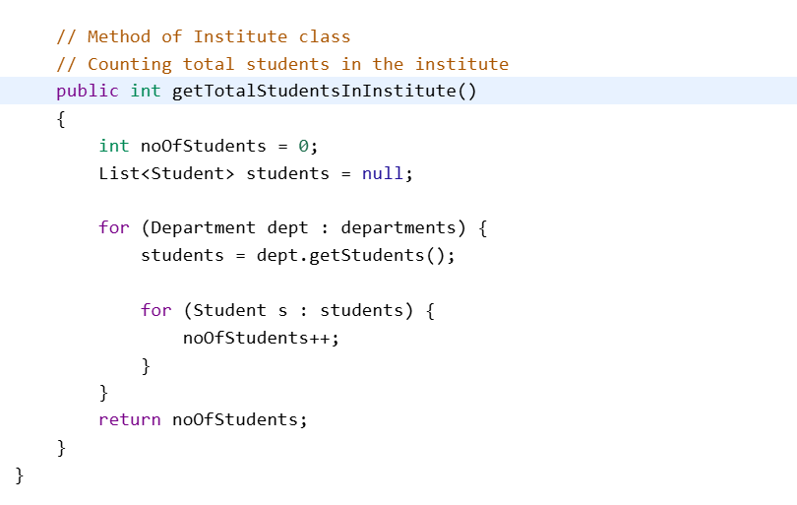

Slide 14
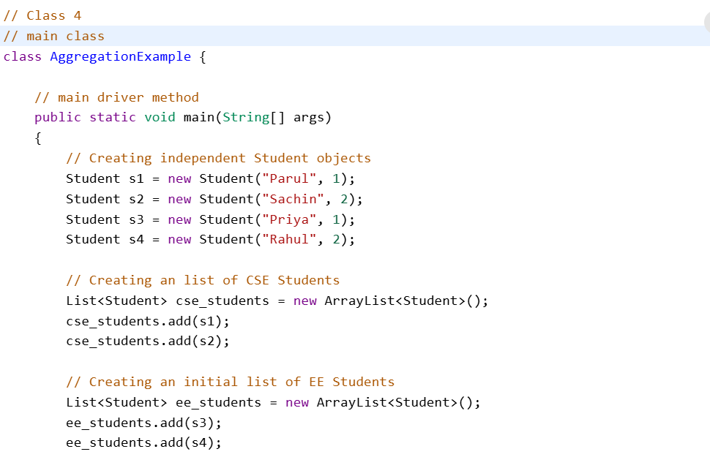

Slide 15
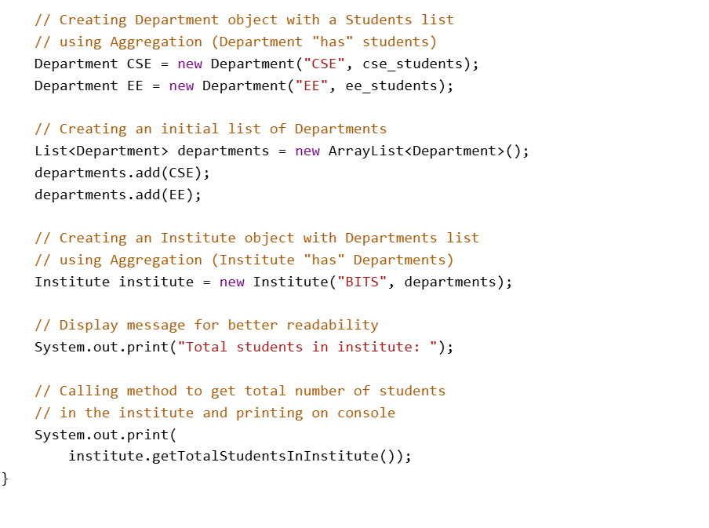

Slide 16
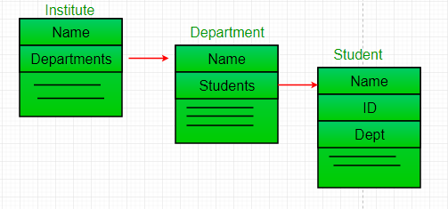
Aggregation Example

Slide 17
Composition
Composition is a stronger form of aggregation that means ownership and lifecycle dependence; if the whole gets destroyed, then the parts no longer exist.
For example a house and its different rooms; a room cannot exist without a house.

Slide 18
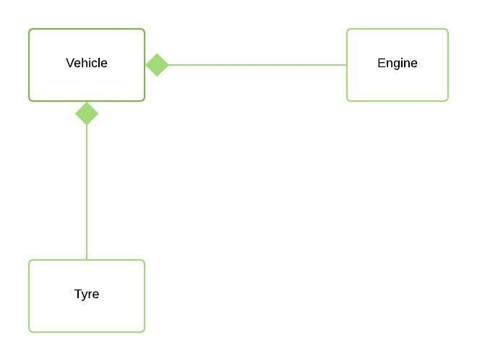
Composition Example

Slide 19
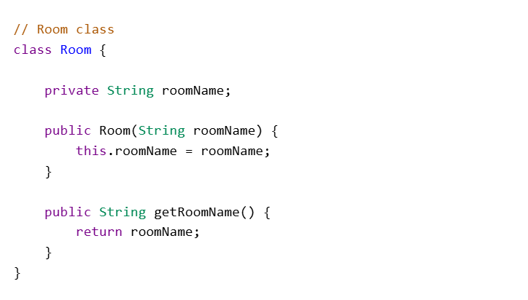
Code Example

Slide 20
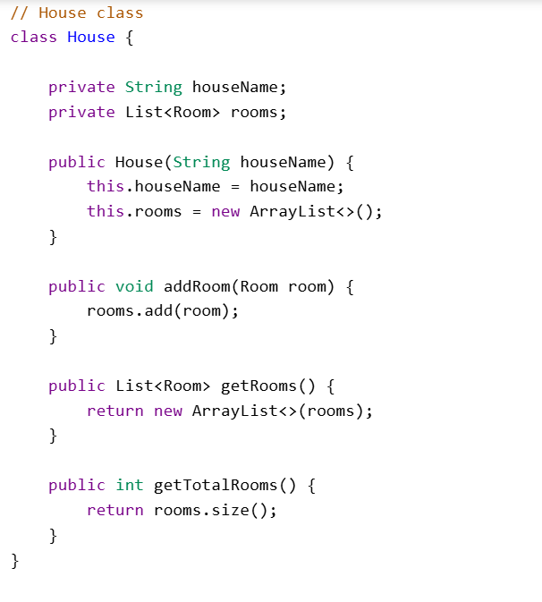

Slide 21
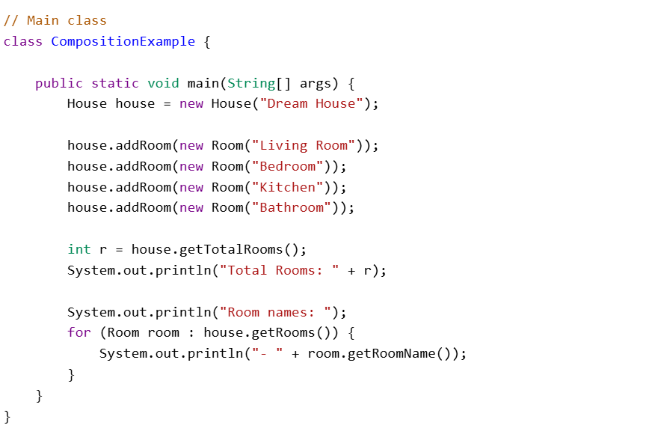

Slide 22
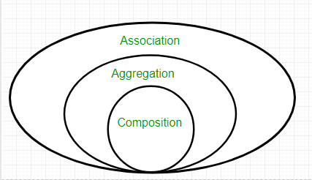
Overall Comparison

Slide 23
Reference
https://www.geeksforgeeks.org/java/association-composition-aggregation-java/

